Slide 1
Predicting Data Breaches with Machine Learning and Geospatial Analysis: A Focus on Data Type and Regional Vulnerabilities
Yuta Sugiyama
WK01-WK05
Revision 2023.09.26
CDS-492 | Fall 2023 | Dr. Slamani

Slide 2
Week - 01

Slide 3
Outline
WK01 - Topic search
Topic title
Topic summary
Rationale
Possible issues
WK01 - Literature review
Paper title
Paper citation
Summary of what was investigated
Processing algorithms
What I liked about the paper
What additions I can provide to the topic

Slide 4
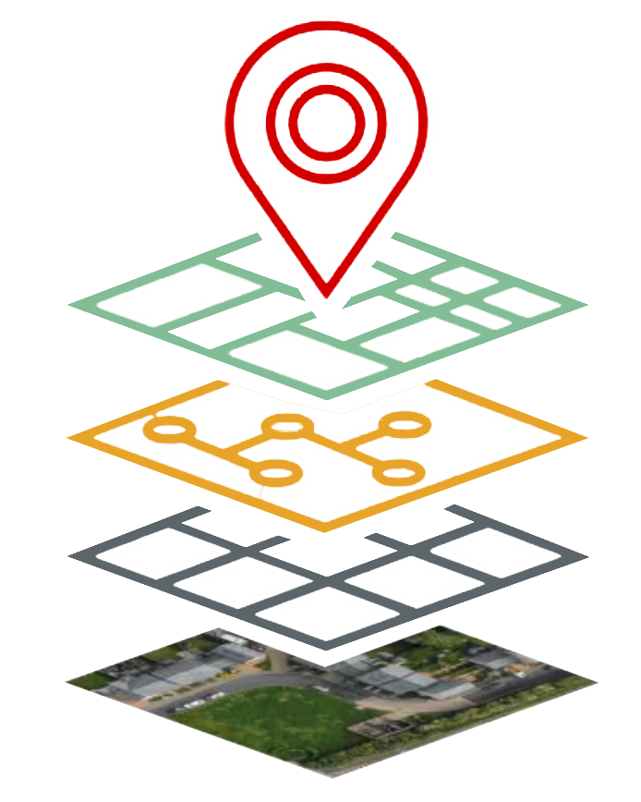
Topic Background
Topic summary
Data breaches occur when unauthorized people get a hold of private information, which has increased in its frequency and severity. These data breaches can lead to financial loss, harm a reputation, and result in legal trouble for the people and organizations involved. These breaches have increased in frequency and severity; therefore, experts are using sophisticated technologies like machine learning and geospatial analysis to forecast and prevent data breaches. In cybersecurity, there seems to be a missing component in efforts, which is geographical information.
In this study, The data breaches will be analyzed along with geographic information to identify regions or countries that are more susceptible to data breaches, considering factors like cyber-infrastructure, policies, and regulations.

Slide 5

Rationale
Benefits of Geographical Locations of Data Breaches
Predicting data breaches in regions could be used to give a localized risk assessment
Allocate more security and resources
Predict data breaches
Improve regulations and policies
Target security measures for the region

Slide 6
Foreseeable Issues
What issues can be expected to address the topic?
Data Integrity
Inaccurate or biased data can lead to incorrect predictions and decisions.
Privacy
When predicting and reducing data breaches, it's important to keep a balance between using data effectively and respecting privacy rights of individuals.
Feature selection
Identifying the most relevant features of the data, while removing noise is important
Bias and Generalization
It's important to ensure that predictions are not unfairly influenced by factors like race, gender, or other sensitive attributes.

Slide 7
WK01 – Literature Review | Paper 1
Paper title
Examining the correlates and spatial distribution of organizational data breaches in the United States
Paper citation
Khey, D. N., & Sainato, V. A. (2013). Examining the correlates and spatial distribution of organizational data breaches in the United States. Security Journal, 26(4), 367–382. https://doi.org/10.1057/sj.2013.24
Summary of what was investigated
The article investigates organizational data breaches in the United States, focusing on their geospatial patterns and situational prevention strategies. It explores the geographical distribution of data breaches across US counties and notes their clustering. The study used Routine Activity Theory and Situational Crime Prevention (SCP) to analyze these breaches. It discusses four dimensions of incident clusters: behaviors, place and space, persons, and time. The application of SCP techniques, like target hardening, access control, and self-policing, reduces the risk of data breaches and highlights the need for further research to better understand and mitigate this cybercrime issue.

Slide 8
WK01 – Literature Review | Paper 1 (cont.)
Processing algorithms
The article does not mention the specific processing algorithms used in each paper. It primarily discusses concepts, theories, and findings related to geospatial patterns of organizational data breaches and situational crime prevention strategies.
What I liked about the paper
I liked that this paper is a predecessor to what my research project will visually show and its integration of theories within its study.
What additions I can provide to the topic
This project will provide the research to further emphasize that data breaches are correlated by geospatial distribution, while visually depicting the detected anomalies in a region of a country in real-time.

Slide 9
Week - 02

Slide 10
Outline
WK02 – Review/revise work from previous week(s)
Summary of changes
WK02 – Literature review Paper 2
Paper title
Paper citation
Summary of what was investigated
Processing algorithms
What I liked about the paper
What additions I can provide to the topic
WK02 - Literature review Paper 3
Paper title
Paper citation
Summary of what was investigated
Processing algorithms
What I liked about the paper
What additions I can provide to the topic

Slide 11
WK02 – Review/revise work from previous week(s)
Below is a summary of changes made and slide numbers
Splitting up information about the topic chosen to discuss the background, benefits, and any foreseeable issues.
Elaborations on each topic category
Addition of diagrams and pictures
Literature Review slides

Slide 12
WK02 – Literature Review | Paper 2
Paper title
How Data Breaches Affect Consumer Credit
Paper citation
Mikhed, V., & Vogan, M. (2018). How data breaches affect consumer credit. Journal of Banking and Finance, 88, 192–207. https://doi.org/10.1016/j.jbankfin.2017.12.002
Summary of what was investigated
The study investigated the response of consumers to the 2012 South Carolina Department of Revenue data breach, focusing on their adoption of fraud protection services and changes in credit behavior. The study analyzed how affected individuals acquired different fraud protection services and examined whether news coverage of the breach influenced their responses. Geospatial data was utilized to understand how breach-related responses varied across different geographic areas, such as regions that shared media markets across states. Overall, this study wanted to find a correlation of knowing about a data breach affects people taking steps to increase their security.
Results
People who were directly affected by the data breach were more likely to get fraud protection services, but the breach didn't really change their credit card use or other financial behaviors. Interestingly, people who heard about the breach in the news but weren't directly affected didn't seem to take extra steps to protect themselves, showing that just knowing about a breach might not make people act differently.

Slide 13
WK02 – Literature Review | Paper 2
What processing algorithms did the paper use
The paper used statistical analysis techniques such as logistic regression to process and analyze the data, and geospatial data analysis to understand how individuals in different geographic areas responded to the breach and news coverage.
What you liked about the paper
I liked how important questions about consumer behavior and the impact of data breaches on individuals' decisions to adopt fraud protection measures were addressed. Also, the use of geospatial data adds an interesting dimension to the analysis, allowing for insights into regional variations in responses to data breach information.
What additions you can provide to the topic
ML can be used to develop predictive models that forecast individuals' likelihood of adopting fraud protection measures after a data breach. ML algorithms could provide more accurate insights into the factors influencing post-breach behaviors, assisting in consumer protection and communication.

Slide 14
WK02 – Literature Review | Paper 3
Paper title
Modified VAST Challenge with Applications to Data Breaches
Paper citation
Carr, R. Modified VAST Challenge with Applications to Data Breaches. Challenge, 2, 9.
Summary of what was investigated
This scholarly article focused on developing interactive tools to visualize and explore a recontextualized dataset from the 2021 VAST Challenge Mini Challenge 2. Specifically, it explored ways to link credit card and loyalty card data to uncover patterns and anomalies. The investigation also delved into using geospatial data to trace the movements of employees and identify potential security risks.
Results
Challenges arose within this study due to complex data and unworkable geospatial information, making certain aspects of the investigation difficult to accomplish. .

Slide 15
WK02 – Literature Review | Paper 3
What processing algorithms did this paper use
The processing algorithms used are data linking, data abstraction and exploration, geospatial data conversion, and data cleaning.
What you liked about the paper
I like how the paper chooses practical data processing techniques for the dataset, iwhich includes: data abstraction, geospatial conversion, and interactive visualization, to explore the dataset's nuances and limitations.
What additions you can provide to the topic
I could add ML anomaly detection algorithms or clustering techniques, which can help identify unusual patterns/relationships in the data that might identify potential breaches or suspicious activities.

Slide 16
WK02 – Synthesis Matrix
Sources | Research question/hypothesis | Methods | Findings | Strengths | Limitations
Where is the current work located? Reference to source. Must use a consistent citation format. | What issue is the paper addressing? The research question that the paper sets out to answer, or a hypothesis that the authors set out to support or disprove. | How was it performed? What approaches, methods, tools and techniques were used? | What did they find? Describes the data that was collected and the results of any statistical tests/analysis that were performed. | What was particularly good about the paper? This section typically highlights the major contribution about the current work. | What were the shortcoming of the current work? What could be done to improve the current work.
Paper 1 | How are organizational data breaches distributed geospatially in the United States? What are the underlying factors contributing to these distribution patterns? | Data collection, Routine Activity Theory, Situational Crime Prevention (SCP), and geospatial analysis. | Evidence supporting the geospatial clustering of data breaches in specific US counties. Implementation of measures like target hardening and access control reduces the occurrence of data breaches. | The applied theory, geospatial analysis, and situational prevention strategies. | Data quality, generalization of other countries, and various factors and aspects unknown.
Paper 2 | How do data breaches affect consumer credit behavior, adoption of fraud protection services, and response to news coverage of breaches? | Data collection, Logistic regression, geospatial analysis, and comparison of affected and unaffected. | Individuals directly affected by the data breach were more likely to adopt fraud protection services. The breach didn’t significantly change the credit card use or other financial behaviors of affected individuals. Individuals who heard about the breach in the news but were not directly affected did not exhibit significant changes in behavior. | Real world applications, showing the affect of data breaches. Geospatial analysis giving valuable insights into how breach-related responses vary across different geographic areas, | Data source accuracy, long-term behavioral changes, and external factors.
Paper 3 | How can interactive visualization tools and practical data processing techniques be applied to recontextualized datasets to uncover patterns, anomalies, and potential security risks, particularly in the context of data breaches? | Data linking, geospatial data conversion, and data visualization. | The dataset presented challenges due to its complexity and unworkable geospatial data. Data abstraction, geospatial conversion, and interactive visualization were effective techniques for uncovering insights. | The data processing addresses real-world challenges within complex datasets. | Complexity of data and its application to specific scenarios and data quality.

Slide 17
WK02 – Data Search
Where did you find the data
I found the dataset on the state of Massachusetts's website of the Office of Consumer Affairs and Business Regulation. https://www.mass.gov/lists/data-breach-reports
Describe the relevancy of the data to your project
It was difficult to find a dataset with data breaches with a specific location, but this dataset can be useful due to it having the business entities, which is only in the state of Massachusetts. This can help pinpoint what companies or areas have the most breaches. The dataset is a report of data breaches of businesses within Massachusetts and includes their assigned breach number, date, organization name, breach type, residents affected, and if the SSN, bank account number, driver license, and credit/debit card are compromised.

Slide 18
Week - 03

Slide 19
Outline
WK03 – Review/revise work from previous week(s)
Summary of changes
WK03 – Class Folder
Creation of shared project folder
WK03 – Workflow Diagram
WK03 – Project Purpose and Questions
Purpose
Motivation
Examples to explain motivation
Benefits: affected stakeholders and how
Research questions
Revised Title
WK03 – Data
Data information
Format
Variable information
Statistical analysis of numerical values
Plot of 2 parameters

Slide 20
WK03 – Review/revise work from previous week(s)
Below is a summary of changes made and slide numbers
More Readable title for the Project
Split up Literature reviews for readability

Slide 21
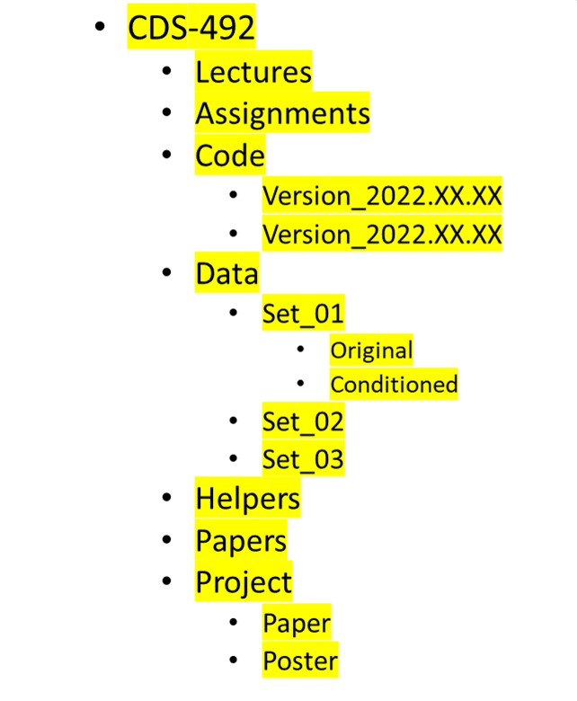
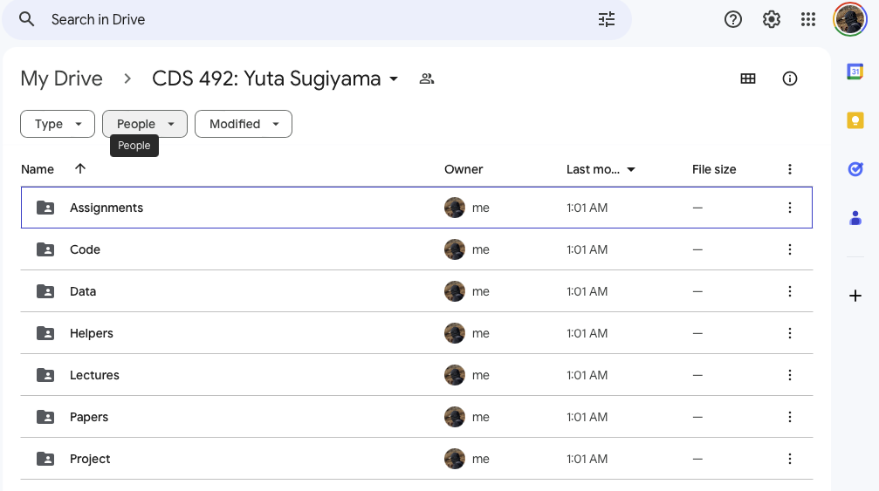
WK03 – Class Folder
Class Folder
Create a folder structure as shown in the picture
Put files in respective folders (e.g., papers, assignments, etc.)
Put the folder in Onedrive or Google Drive
Share the folder with the teacher (aslaman@gmu.edu)
Screenshot of created folder

Slide 22
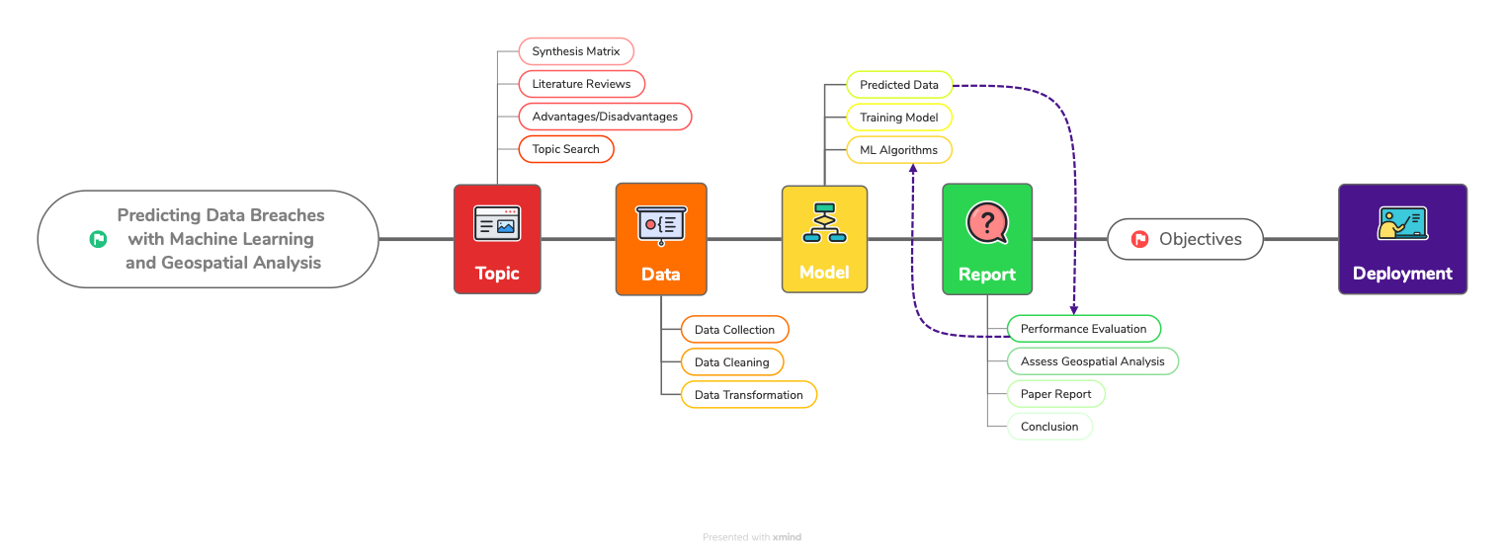
WK03 – Workflow diagram

Slide 23
WK03 – Project Purpose and Questions
Project purpose
The purpose of this project is to utilize machine learning and geospatial analysis to predict and determine organized data breaches by considering the type of PPI targeted (e.g., credit card information, social security numbers) and the geographical locations where these breaches occur.
Motivation
The motivation for this project is from the increasing frequency and severity of data breaches, which have significant consequences, including financial losses, reputation damage, and legal ramifications. The existing cybersecurity efforts often lack a geographical component; therefore, making this essential to incorporate geographic information to enhance breach prediction and prevention strategies.
Examples to explain the motivation for the project topic
Major retail chains have faced substantial financial losses and damage to their reputation due to data breaches, highlighting the urgent need for more precise and location-aware breach prediction strategies.
Government agencies have struggled to protect citizens' sensitive information in different regions, and the project aims to provide them with tools to tailor their cybersecurity measures based on geographical risk factors.

Slide 24
WK03 – Project Purpose and Questions
Benefit(s) of the project (benefits who and how)
Benefits | Localized Risk Assessment | Targeted Resource Allocation | Improving Regulations and Policies | Targeted Security Measures
Who | Any type of organization, government agencies, businesses operating in different regions, and individuals/consumers. | Any type of organization, government agencies, and businesses operating in different regions. | Policymakers, regulatory bodies, and government agencies responsible for cybersecurity. | Any type of organization, government agencies, businesses operating in different regions, and individuals/consumers.
How | By analyzing data breaches in relation to geographical locations, stakeholders can identify regions that are at a higher risk of data breaches | Predictive analysis can help these entities allocate their resources, such as cybersecurity personnel, tools, and budgets, more efficiently. | By gaining insights into data breach patterns across different regions, policymakers and regulatory bodies can develop and enhance regulations and policies that address regional vulnerabilities. | With a better understanding of which regions and data types are at higher risk, entities can implement targeted security measures.

Slide 25
WK03 – Project Purpose and Questions
Research questions
Are certain geographical regions more susceptible to data breaches than others?
Can ML models effectively predict data breaches by analyzing both the type of data targeted (e.g., credit card information, social security numbers) and the geographical locations where they occur?
Is there evidence to suggest that some data breaches are organized, and if so, can geospatial analysis provide insights into the patterns and motivations behind organized data breaches?
Revised title (if needed)
Predicting Data Breaches with Machine Learning and Geospatial Analysis: A Focus on Data Type and Regional Vulnerabilities

Slide 26
WK03 – Data
Data Information
Size of the data (This will be larger as I complete the entire dataset from 2007-2023)
Number of columns: 13
Number of rows: 1603
File size in MB: 0.122MB
Format
The format was in PDF for each report year
I will compile a dataset from 2007-2023 reports into a CSV file.

Slide 27
WK03 – Data
Column | Assigned Breach Number 1 | Date Reported 2 | Organization Name 3 | Breach Type Description 4 | Breach Occurrence at Reporting Entity? 5 | MA Residents Affected 6 | SSN Breached? 7 | Account Number Breached? 8 | Driver’s Licenses Breached? 9 | Credit Debit Numbers Breached? 10 | Provided Credit Monitoring 11 | Data Encrypted 12 | Mobile Device Lost Stolen 13
Data Type | Numerical | Date | Categorical | Categorical | Boolean | Numerical | Boolean | Boolean | Boolean | Boolean | Boolean | Boolean | Boolean
Description | A unique identifier for each data breach incident. | The date when the data breach occurred. | The name of the business or organization affected by the data breach. | The format in which the data was compromised, such as "Electronic" or "Paper.” | Whether the breach occurred at the reporting entity. | How many Massachusetts residents were affected by this breach | Whether Social Security Numbers (SSNs) were compromised, with values like "Yes" or empty cells. | Whether account numbers were compromised. | Whether driver’s license numbers were compromised. | Whether credit/debit card numbers were compromised. | Whether the organization offers credit monitoring to individuals/consumers. | Whether data was encrypted or not for that organization. | Whether mobile device was lost or stolen.

Slide 28
WK03 – Data
Statistical Analysis of Numerical Values
Statistic | Assigned Breach Number | MA Residents Affected
Min | 28815.000000 | 0.000000e+00
Max | 30438.000000 | 2.109381e+06
Mean | 29630.948222 | 2.557919e+03
Median | 29631.000000 | 4.000000e+00
Standard Deviation | 465.385347 | 5.434073e+04

Slide 29
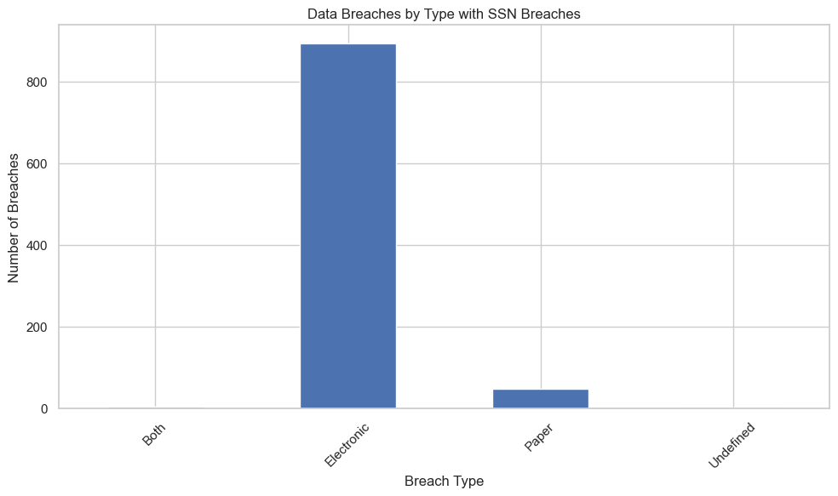
WK03 – Data
Plot of parameters SSNBreached and Data Breach Description

Slide 30
Week - 04

Slide 31
Outline
WK04 – Review/revise work from previous week(s)
Summary of changes
WK04 – Project Workflow
Updated Project Workflow Diagram
WK04 – Code Workflow
WK04 – Updated Data
Updated Information About Data
Table of Statistics
Plot of Parameters
WK04 – Project Purpose and Questions
Purpose
Motivation
Examples to explain motivation
Benefits: affected stakeholders and how
Research questions
Project objectives
WK04 – Objectives and Parameters

Slide 32
WK04 – Review/revise work from previous week(s)
Below is a summary of changes made and slide numbers
Updated Project Workflow Diagram
Downsizing Phases
Less details
Adding Report phase and subtopics
Data is now updated to the full extent from 2007-2022
Not the 2023 report, due to the goal of the project (predicting and then matching the predicted dataset to the 2023 report)
Zoom call is delayed (person of contact needed to reschedule [date TBD])
Assumption has been affirmed that blanks in the dataset means no instead of null data
During data cleaning/transformation process, I will have to encode “” to mean False or 0 for all Boolean variables.
Organize Data Column Description and Topic Benefits into Table

Slide 33
WK04 – Project Workflow

Slide 34
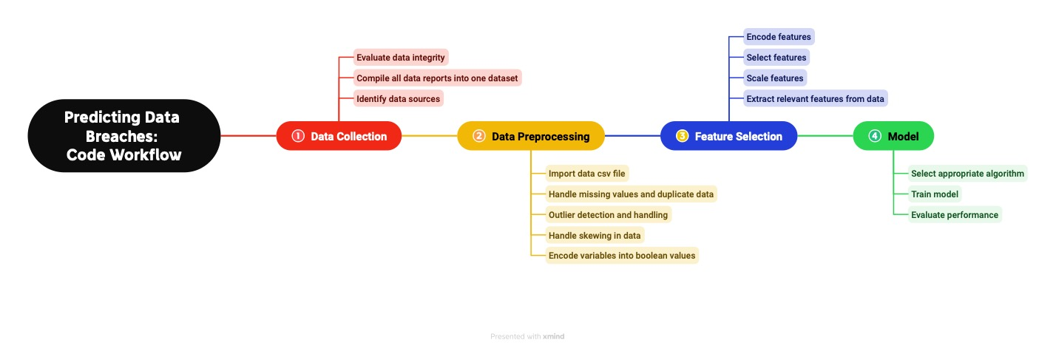
WK04 – Code Workflow

Slide 35
WK04 – Updated Data
Data Information
Size of the data
Number of columns: 13
Number of rows: 22994
File size in MB: 1.5MB
Format
The original format was in PDF for each report year, which were converted to a XLSX file then, a CSV file.
The dataset from 2007-2022 reports are in a CSV file.
The 2023 Report will be compared to the predicted dataset.

Slide 36
WK04 – Updated Data (2)
Column | Assigned Breach Number 1 | Date Reported 2 | Organization Name 3 | Breach Type Description 4 | Breach Occurrence at Reporting Entity? 5 | MA Residents Affected 6 | SSN Breached? 7 | Account Number Breached? 8 | Driver’s Licenses Breached? 9 | Credit Debit Numbers Breached? 10 | Provided Credit Monitoring 11 | Data Encrypted 12 | Mobile Device Lost Stolen 13
Data Type | Numerical | Date | Categorical | Categorical | Boolean | Numerical | Boolean | Boolean | Boolean | Boolean | Boolean | Boolean | Boolean
Description | A unique identifier for each data breach incident. | The date when the data breach occurred. | The name of the business or organization affected by the data breach. | The format in which the data was compromised, such as "Electronic" or "Paper.” | Whether the breach occurred at the reporting entity. | How many Massachusetts residents were affected by this breach | Whether Social Security Numbers (SSNs) were compromised, with values like "Yes" or empty cells. | Whether account numbers were compromised. | Whether driver’s license numbers were compromised. | Whether credit/debit card numbers were compromised. | Whether the organization offers credit monitoring to individuals/consumers. | Whether data was encrypted or not for that organization. | Whether mobile device was lost or stolen.

Slide 37
WK04 – Updated Data (3)
Sample Data
Assigned Breach Number | Date Reported To OCA | Organization Name | Breach Type Description | Breach Occur at the Reporting Entity? | MA Residents Affected | SSN Breached | Account Number Breached | Drivers Licenses Breached | Credit Debit Numbers Breached | Provided Credit Monitoring | Data Encrypted | Mobile Device Lost Stolen
250 | 8/16/2007 | Hewlett Packard Company | Electronic |  | 52 | Yes |  |  |  | Yes |  | Yes
252 | 9/11/2007 | Kraft Foods | Electronic |  | 460 | Yes |  |  |  | Yes |  | Yes
244 | 9/12/2007 | The Hartford | Electronic |  | 18 | Yes | Yes |  |  | Yes
270 | 9/21/2007 | Symantec Corporation | Undefined |  | 1 | Yes |  |  |  | Yes
243 | 10/5/2007 | The Hartford | Electronic |  |  | Yes |  | Yes |  |  |  | Yes

Slide 38
WK04 – Updated Data (4)
Statistical Analysis of Numerical Values
Statistic | MA Residents Affected
Min | 0
Max | 2982421
Mean | 715
Median | 3
Standard Deviation | 24198
The maximum of 2,982,421 indicates that in some instances, a very large number of Massachusetts residents were affected. This is probably due to a significant event or disaster.
This is around 715 on average. This value gives us an idea of the typical number of residents affected when looking at the dataset.
The median value for MA Residents Affected is 3, which is significantly lower than the mean. This suggests that half of the data points have fewer than 3 Massachusetts residents affected.
The standard deviation is 24,189, which is a high standard deviation. This indicates that the data points are widely spread out from the mean.

Slide 39
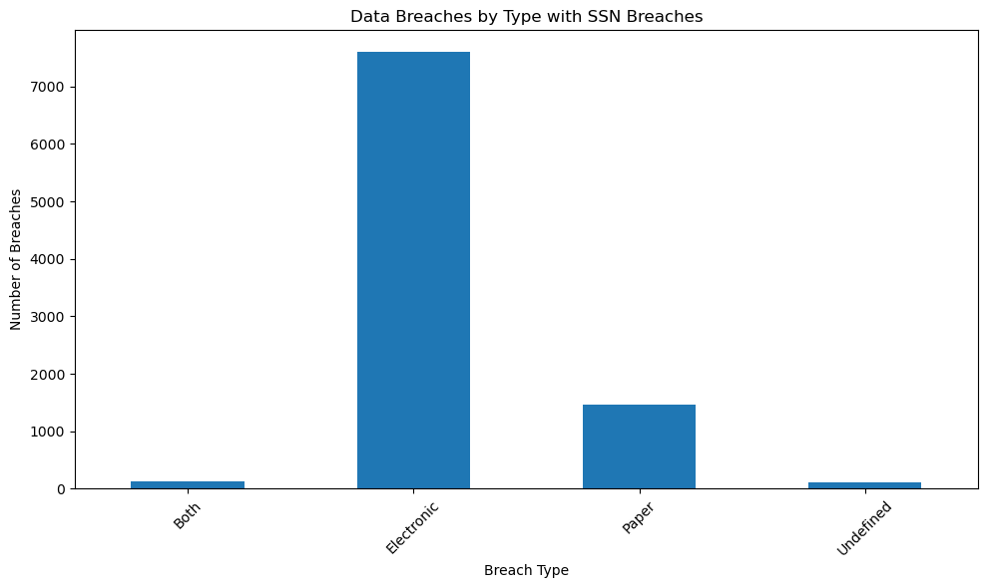
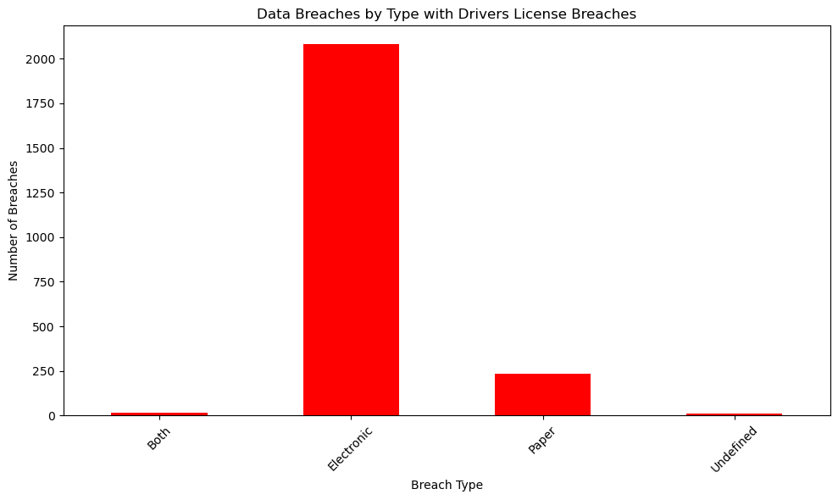
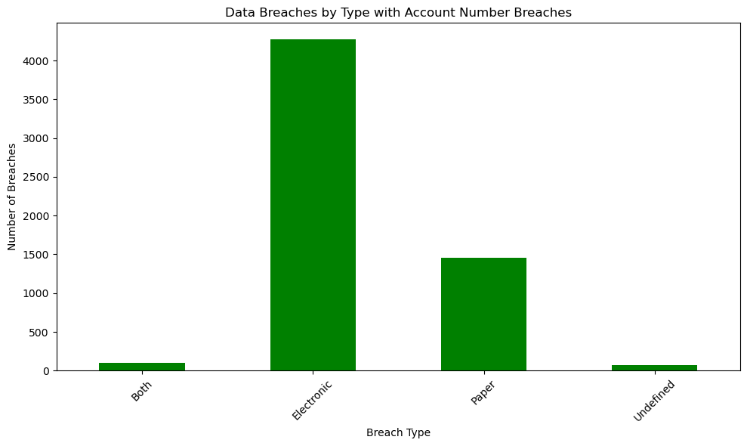
WK04 – Updated Data (5)
With the new and complete dataset, we can see the proportion of targeted data breaches that are electronic, paper, undefined, or both electronic and paper.
In this plot, approximately 38% of the data breaches were by paper.

Slide 40
WK04 – Project Purpose and Questions
Project purpose
The purpose of this project is to predict and determine organized data breaches by considering the type of Personal Personally Identifiable Information (PPI) targeted, such as credit card information or social security numbers, and pinpointing the geographical regions where these breaches are most likely to occur.
Motivation
This project’s motivation stems from the alarming rise in both the frequency and severity of data breaches, which cause issues such as financial setbacks, reputation tarnishing, and legal entanglements. Current cybersecurity efforts frequently overlook a geographical component. This highlights the importance of including geographic data to strengthen our ability to predict and prevent data breaches.
Examples to explain the motivation for the project topic
Major retail chains have faced substantial financial losses and damage to their reputation due to data breaches, highlighting the urgent need for more precise and location-aware breach prediction strategies.
Government agencies have struggled to protect citizens' sensitive information in different regions, and the project aims to provide them with tools to tailor their cybersecurity measures based on geographical risk factors.

Slide 41
WK04 – Project Purpose and Questions (2)
Benefit(s) of the project (benefits who and how)
Benefits | Localized Risk Assessment | Targeted Resource Allocation | Improving Regulations and Policies | Targeted Security Measures
Who | Any type of organization, government agencies, businesses operating in different regions, and individuals/consumers. | Any type of organization, government agencies, and businesses operating in different regions. | Policymakers, regulatory bodies, and government agencies responsible for cybersecurity. | Any type of organization, government agencies, businesses operating in different regions, and individuals/consumers.
How | By analyzing data breaches in relation to geographical locations, stakeholders can identify regions that are at a higher risk of data breaches | Predictive analysis can help these entities allocate their resources, such as cybersecurity personnel, tools, and budgets, more efficiently. | By gaining insights into data breach patterns across different regions, policymakers and regulatory bodies can develop and enhance regulations and policies that address regional vulnerabilities. | With a better understanding of which regions and data types are at higher risk, entities can implement targeted security measures.

Slide 42
WK04 – Project Purpose and Questions (4)
Research questions
Are certain geographical regions more susceptible to data breaches than others?
Is there evidence to suggest that some data breaches are organized?
Can the predicted output explain patterns and motivations behind organized data breaches and insights about their targets?
Project Objectives
Identify regions with varying vulnerabilities to data breaches.
Find evidence of organized data breach activities.
Create a predictive model to understand the patterns and motivations behind organized data breaches and their target selection.

Slide 43
WK04 – Objectives and Parameters
Objectives | Identify regions with varying vulnerabilities to data breaches. | Find evidence of organized data breach activities. | Create a predictive model to understand the patterns and motivations behind organized data breaches and their target selection.
Parameters | Geographical Data Organization Names Possibly demographic info about MA regions MA Residents Affected Provided Credit Monitoring? Mobile Device Lost or Stolen? Data Encrypted? | Geographical Data Organization Names Targeted Data Breached? SSN Credit/Debit Account number Driver’s License | Geographical Data Organization Names Targeted Data Breached? SSN Credit/Debit Account number Driver’s License MA Residents Affected

Slide 44
Week - 05

Slide 45
Outline
WK05 – Review/revise work from previous week(s)
Summary of changes
WK05 – Project Workflow Updated
Updated Project Workflow Diagram
WK05 – Code Workflow Updated
Updated Project Workflow Diagram
WK05 – Updated Data
Updated Information About Data
Table of Statistics (do not have many numerical values)
Plot of Parameters
WK05 – Project Purpose and Questions
Purpose
Motivation
Examples to explain motivation
Benefits: affected stakeholders and how
Research questions
Project objectives
WK05 – Objectives and SMART
WK05 – Updated Objectives and Parameters

Slide 46
WK05 – Review/revise work from previous week(s)
Below is a summary of changes made and slide numbers
Changed plots into faceted plot (more readable)
Better statistic table with explanations of results.
Modified Code Workflow and Project Workflow
Broke off Analysis Phase from Reporting Phase
Updated Objectives and parameters table
Check marks for each parameter column
Highlighted data that’s either not used (red) or not yet attained (yellow)
Reviewed Project motivation, purpose, research questions, objectives, benefits, and examples
Decided that what I currently have does align with the SMART guide.
Elaborated on Specifics, Measurability, Achievability, Relevancy, and Time-bound for each objective

Slide 47
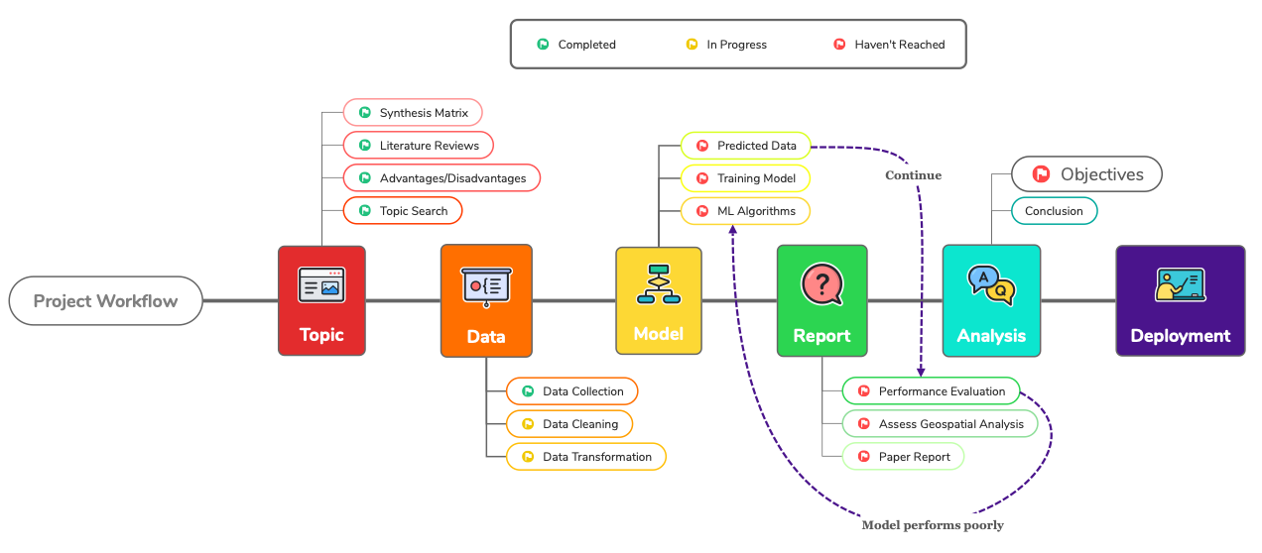
WK05 – Project Workflow Update

Slide 48
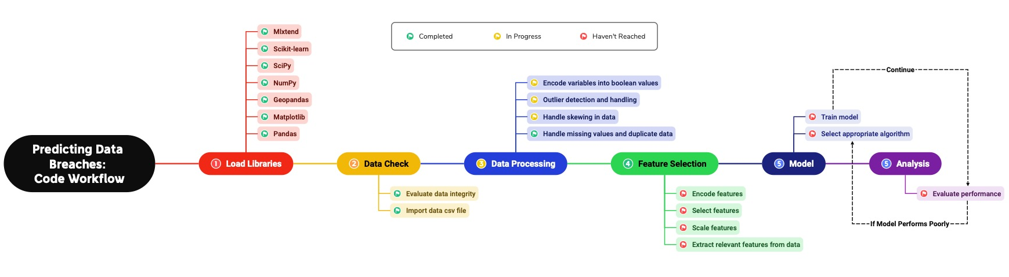
WK05 – Code Workflow Update

Slide 49
WK05 – Updated Data (1)
Statistical Analysis of Numerical Value (MA Residents Affected is the only numerical columns)
Statistic | MA Residents Affected
Min | 0
Max | 2982421
Mean | 715
Median | 3
Standard Deviation | 24198
The maximum of 2,982,421 indicates that in some instances, a very large number of Massachusetts residents were affected. This is probably due to a significant event or disaster.
This is around 715 on average. This value gives us an idea of the typical number of residents affected when looking at the dataset.
The median value for MA Residents Affected is 3, which is significantly lower than the mean. This suggests that half of the data points have fewer than 3 Massachusetts residents affected.
The standard deviation is 24,189, which is a high standard deviation. This indicates that the data points are widely spread out from the mean.

Slide 50
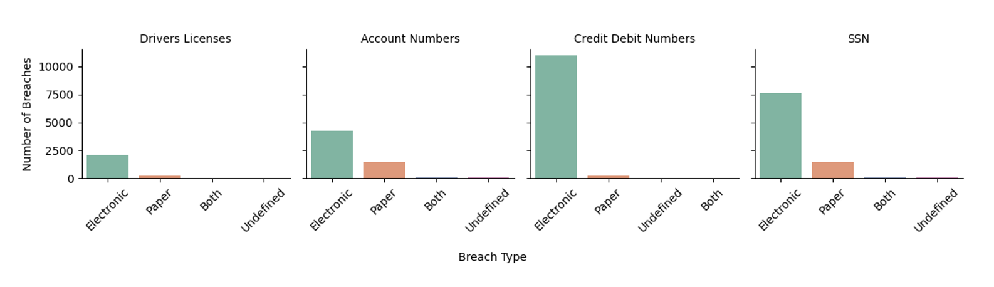
WK05 – Updated Data (2)
Facet Plot with 5 parameters
This is a facet plot that represents the number of data breaches based on different breach types.
Explanation of the lowest and highest values for each plot:
Credit/Debit Numbers has the highest count of electronic type data breaches, while Driver’s licenses has the lowest.
They both have about the same count of paper type breaches.
Approximately 40% of the total count of account number data breaches are paper type breaches.

Slide 51
WK05 – Project Purpose and Questions (1) (Revise)
Project purpose
The purpose of this project is to predict and determine organized data breaches by considering the type of Personal Identifiable Information (PII) targeted, such as credit card information or social security numbers, and pinpointing the geographical regions where these breaches are most likely to occur.
Motivation
This project’s motivation stems from the alarming rise in both the frequency and severity of data breaches, which cause issues such as financial setbacks, reputation tarnishing, and legal entanglements. Current cybersecurity efforts frequently overlook a geographical component. This highlights the importance of including geographic data to strengthen our ability to predict and prevent data breaches.
Examples to explain the motivation for the project topic
Major retail chains have faced substantial financial losses and damage to their reputation due to data breaches, highlighting the urgent need for more precise and location-aware breach prediction strategies.
Government agencies have struggled to protect citizens' sensitive information in different regions, and the project aims to provide them with tools to tailor their cybersecurity measures based on geographical risk factors.

Slide 52
WK05 – Project Purpose and Questions (2) (Revise)
Benefit(s) of the project (benefits who and how)
Benefits | Localized Risk Assessment | Targeted Resource Allocation | Improving Regulations and Policies | Targeted Security Measures
Who | Any type of organization, government agencies, businesses operating in different regions, and individuals/consumers. | Any type of organization, government agencies, and businesses operating in different regions. | Policymakers, regulatory bodies, and government agencies responsible for cybersecurity. | Any type of organization, government agencies, businesses operating in different regions, and individuals/consumers.
How | By analyzing data breaches in relation to geographical locations, stakeholders can identify regions that are at a higher risk of data breaches | Predictive analysis can help these entities allocate their resources, such as cybersecurity personnel, tools, and budgets, more efficiently. | By gaining insights into data breach patterns across different regions, policymakers and regulatory bodies can develop and enhance regulations and policies that address regional vulnerabilities. | With a better understanding of which regions and data types are at higher risk, entities can implement targeted security measures.

Slide 53
WK05 – Project Purpose and Questions (3) (Revise)
Research questions
Are certain geographical regions more susceptible to data breaches than others?
Is there evidence to suggest that some data breaches are organized?
Can the predicted output explain patterns and motivations behind organized data breaches and insights about their targets?
Project Objectives
Identify regions with varying vulnerabilities to data breaches.
Find evidence of organized data breach activities.
Create a predictive model to understand the patterns and motivations behind organized data breaches and their target selection.

Slide 54
WK05 – Objectives and SMART (1)
Objective 1 | Identify regions with varying vulnerabilities to data breaches.
Specific | Regions with the most/less breaches over time will be identified.
Measurable | By quantifying and comparing the vulnerabilities in different regions, through a vulnerability score or index or through EDA.
Achievable | Conducting vulnerability assessments in different regions.
Relevant | Understanding regional vulnerabilities is crucial for predicting data breaches within the cybersecurity industry.
Time-bound | Regions will be identified by Week 7 or 8
Objective 2 | Find evidence of organized data breach activities.
Specific | Aiming to locate areas with the same type of data breach and targeted data.
Measurable | By finding a presence within the type of breach and targeted data within that region.
Achievable | Investigating and analyzing data to detect patterns of organized data breaches.
Relevant | Addresses the objective of identifying organized breach activities within an organization.
Time-bound | Evidence will be identified in Week 8 or 9

Slide 55
WK05 – Objectives and SMART (2)
Objective 3 | Create a predictive model to understand the patterns and motivations behind organized data breaches and their target selection.
Specific | Identifying the motivations behind data breaches by finding relationships between breaches using location, organization info, and target selection.
Measurable | Predictive model will be analyzed based on its accuracy in performance.
Achievable | Using ML python libraries and data analysis techniques.
Relevant | Understanding the underlying factors and motivations behind hackers and cyber criminals
Time-bound | Predictive Model will be completed in Week 10
After Week 10, I will be refining the project and working on communicating the results.

Slide 56

WK05 – Objectives and parameters (Review)
 | Assigned Breach Number | Date Reported | Organization Name | Breach Type Description | Breach Occurrence at Reporting Entity? | MA Residents Affected | SSN Breached? | Account Number Breached? | Driver’s Licenses Breached? | Credit Debit Numbers Breached? | Provided Credit Monitoring | Data Encrypted | Mobile Device Lost Stolen | Geographical Location
Identify regions with varying vulnerabilities to data breaches.
Find evidence of organized data breach activities.
Create a predictive model to understand the patterns and motivations behind organized data breaches and their target selection.
Parameters
Objectives

